Slide 1
Critical thinking skills
Dr. V.K. Karthika

Slide 2
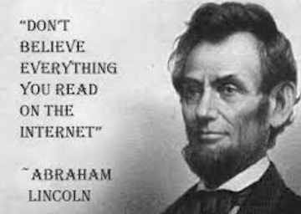

Slide 3
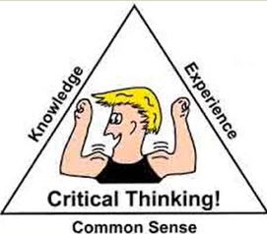
Critical thinking

Slide 4
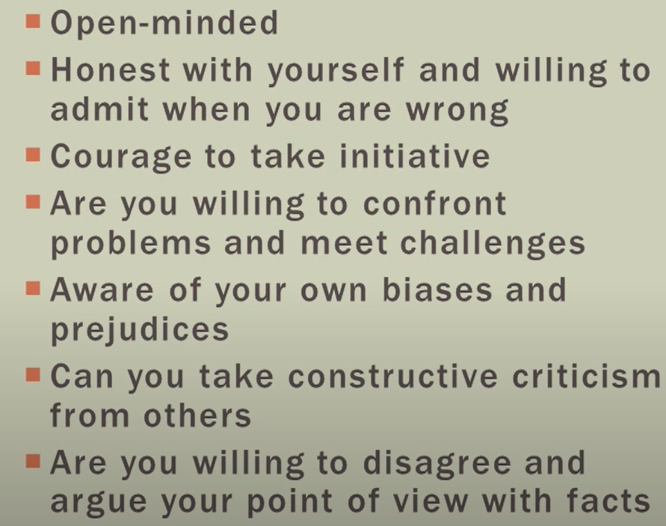
Characteristics of a critical thinker

Slide 5
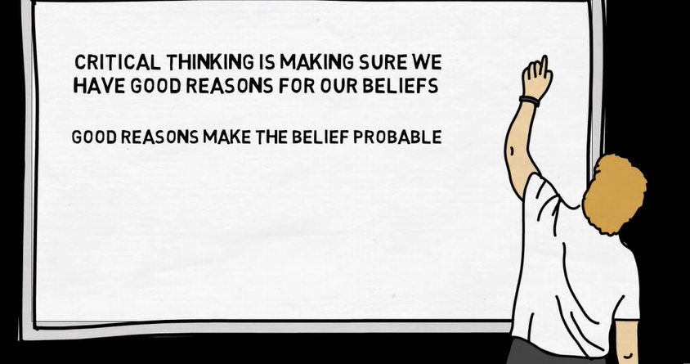

Slide 6
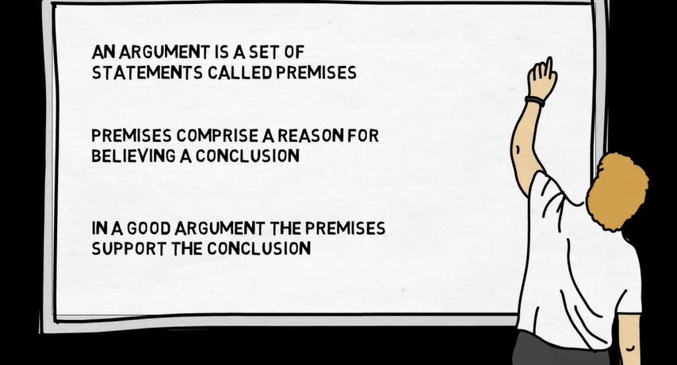

Slide 7
Titan raga- break the bias
Conclusion- Kiran is a young and beautiful modern woman.
Premise/premises- Rajat recommended Kiran.
A man recommends a woman only when she is beautiful and willing for “compromises”.
Or
A man recommends only a woman because he looks for other advantages.

Slide 8
I think Shyam is not going to be there for the party this evening
Why do you think so?
I can’t stand him. He is such an annoying person. Rationally wrong.
He is an introvert and usually avoids parties. Probable % chances are there
He is in the US now.
I think Shyam is not going to be there for the party this evening, because he is in the US now. - certainity
I think Shyam is not going to be there for the party this evening, because he is an introvert and usually avoids parties. - probability

Slide 9
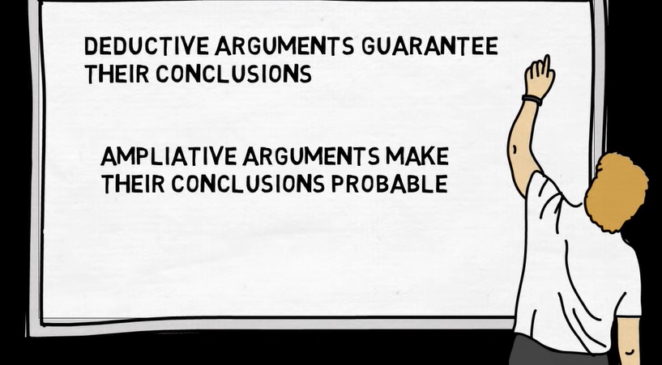

Slide 10
I think Shyam is not going to be there for the party this evening, because he is in the US now. - certainity- Deductive Argument
I think Shyam is not going to be there for the party this evening, because he is an introvert and usually avoids parties. - probability- Ampliative Argument

Slide 11
SIX TYPES OF SOCRATIC QUESTIONS
Questions for clarification | Why do you say that? What do you mean by…? How does this relate to our discussion?
Questions that probe assumptions | What could we assume instead? How can you verify or disapprove that assumption? On what basis do we think this way?
Questions that probe reasons and evidence | What would be an example? What is....analogous to? What do you think causes to happen...? Why?
Questions about viewpoints and perspectives | What would be an alternative? What is another way to look at it? Why is … the best? What are the strengths and weaknesses of...? How are...and ...similar? What is a counterargument for...?
Questions that probe implications and consequences | What generalizations can you make? What are the consequences of that assumption? What are you implying? How does...affect...? How does...tie in with what we learned before?
Questions about the question | What was the point of this question? Why do you ask this question? What does...mean? How does...apply to everyday life?

Slide 12
Critical reading
ANALYSIS
Is the author an expert/academic?
What kind of reasons/evidence has the author provided for their main argument and how relevant and reliable are these reasons/evidence?
How convincing is the overall argument? Why (not)?
Are there any assertions in the article/text that are unsupported?
Has something been omitted? What and why?
How effective is the language on the strength of the overall argument?
Is the conclusion reasonable?

Slide 13
Critical reading
EVALUATION
What are the strengths and weaknesses of this text?
What is your position on the subject?
How does it differ from the argument in the text?
How will you use the text?
How does this text relate to other information you have read?
Does it contradict, support or challenge other evidence?
How is this text significant to your research?
What can be learnt from it?
What else needs considering?
Which aspects of this argument would you like to investigate further?

Slide 14
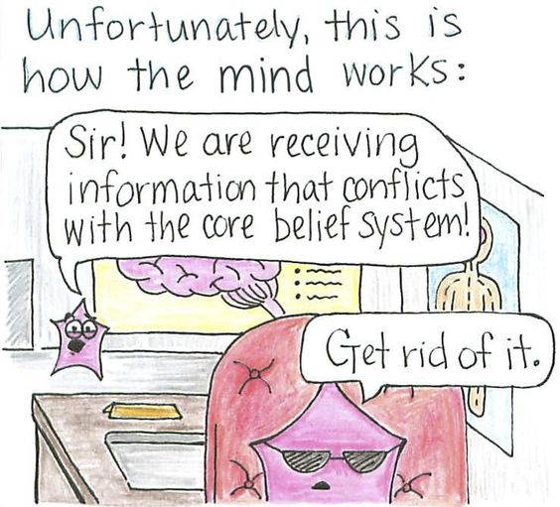
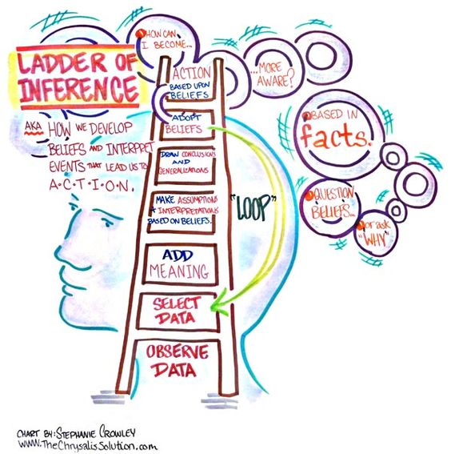
Ladder of inference

Slide 15
Ways to improve critical thinking
Being mindful of confirmation bias
Avoid simplification and look for nuances
fostering intellectual humility
check the credibility of your information

Slide 16
How does Holmes’ think?
An excerpt from a short story “ The Adventure of Gloria Scott”
“ I might suggest that you have gone about in fear of some personal attack within the last twelve months”
............
“ You have a very handsome stick” I answered. “By the inscription I observed that you had not had it more than a year. But you have taken some pains to bore the head of it and pour melted lead into the hole so as to make it a formidable weapon. I argued that you would not take such precautions unless you had some danger to fear”.

Slide 17
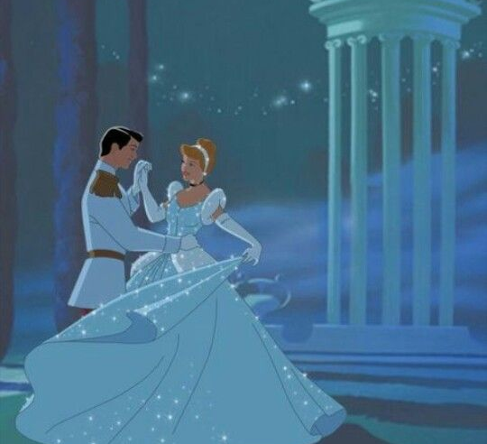
Hone your critical thinking skills
Activity:
Write a six word summary of any of your favorite movie or a book
Six word summary of Cinderella
Example: Servant girl who married the prince

Slide 18
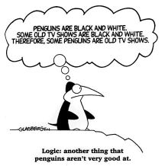

Slide 19
FALLACIES
Commonly divided into 2: formal and
informal fallacies.
Formal fallacies: issue lies in the form/structure, not the content.
The premise may be right, not the conclusion.
Informal fallacies: issue lies in the content/substance, not the form.
Some premise is false.
References: Formal & informal fallacies, Britannica https://www.britannica.com/summary/fallacy

Slide 20
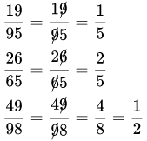
FORMAL FALLACIES
Affirming the consequent: If A is true, B is true. Now, B is true. So, A must be true.
Commutative property in math.
If Hari is cooking, he is free. Hari is free now, so he must be cooking.
Math howlers:
Using wrong mathematical principles to
arrive at the right answer.

Slide 21
INFORMAL FALLACIES
Slippery slope fallacy: Correlation does NOT mean causation. A→B→C→….→Z.
https://www.youtube.com/watch?v=kIv3m2gMgUU&list=PLDZ2gqaRPvrEgW2VthXnA4EOInwjGQNuZ&index=1 – Direct TV Advertisement

Slide 22
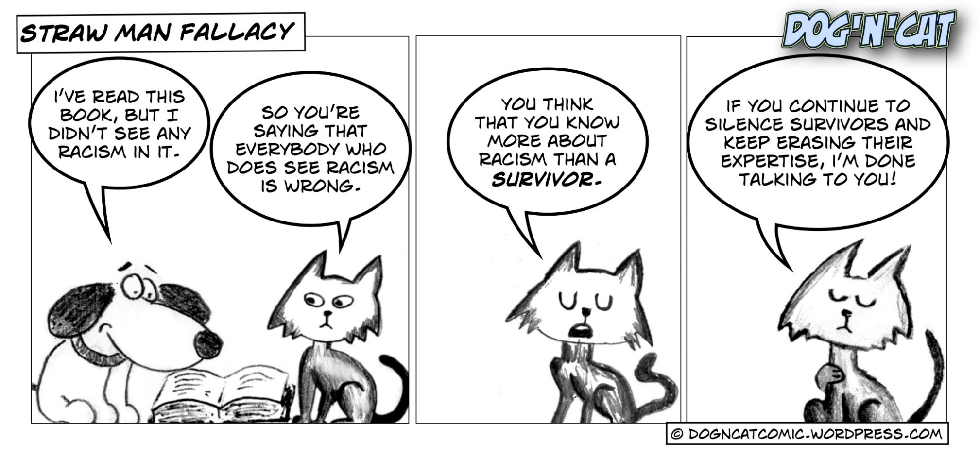
INFORMAL FALLACIES
Straw Man fallacy: Misrepresenting an argument or the person making the argument for an easy target.
A: I like cats more than dogs
B: OH! So, all dogs must be thrown to the dog-catchers then, huh? You advocate animal cruelty! How can you say that?!
Comic credits: Dog’n’Cat Comic https://dogncatcomic.wordpress.com/

Slide 23
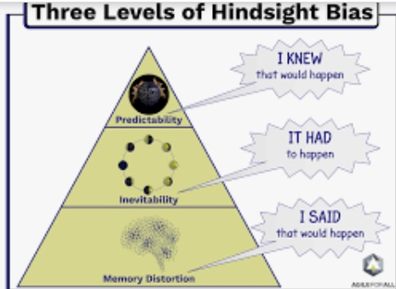
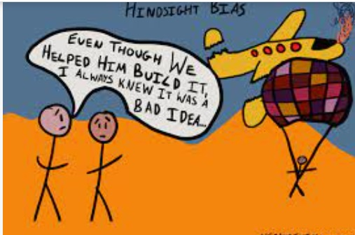
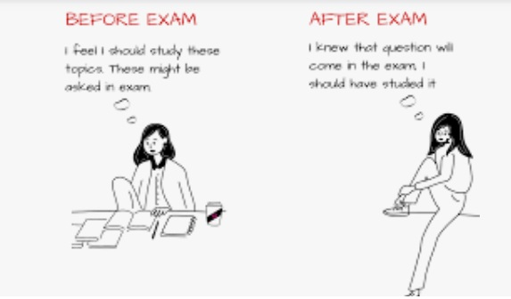
Hindsight Bias

Slide 24
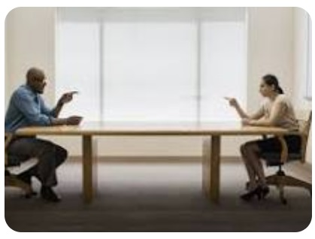
Actor-observer bias
a tendency to attribute one's own actions to external causes while attributing other people's behaviors to internal causes. It is a type of attributional bias that plays a role in how we perceive and interact with other people

Slide 25
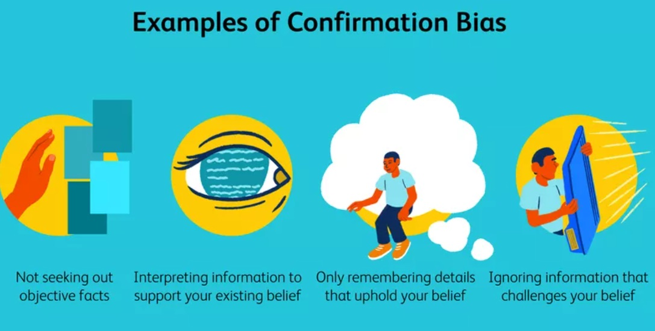
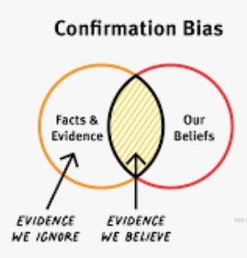
Confirmation bias

Slide 26
Halo effect Fallacy
“I remember being surprised a few years ago when I was working for a company and I assumed by the way the CEO presented himself that he lived this lavish lifestyle with luxury accommodations. When I saw him drive up to work one day in his modest (and aged) vehicle, I stood corrected as I realized I had made a snap judgment and filled in the blanks about this person without having any objective knowledge”.

Slide 27
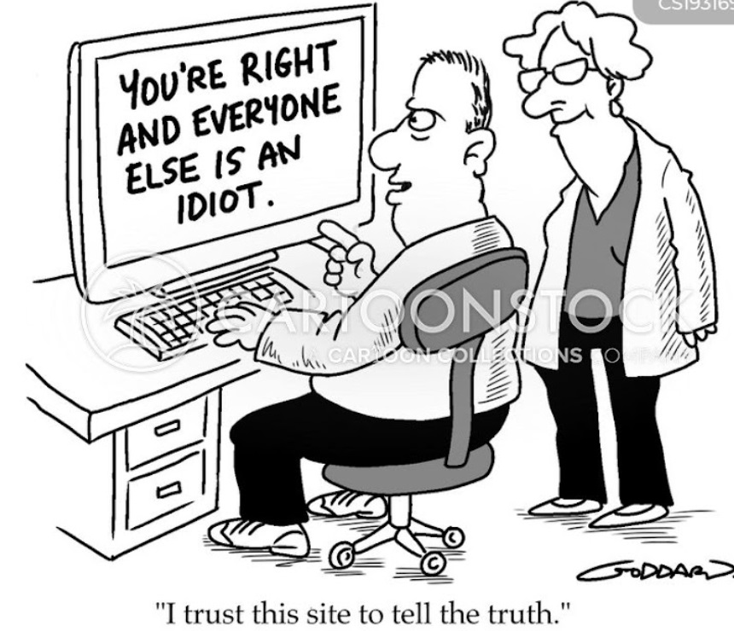
Identify the fallacy

Slide 28
How to spot fallacies - ELSA
Always check if the evidence proves the conclusion .
Check if the argument has logic or if it is simply rhetoric.
See if the form or content present a stand-alone argument or simply attacks on the opposition.

Slide 29
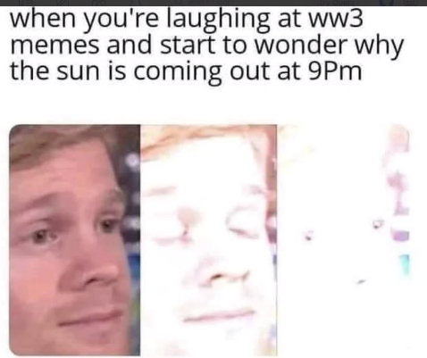
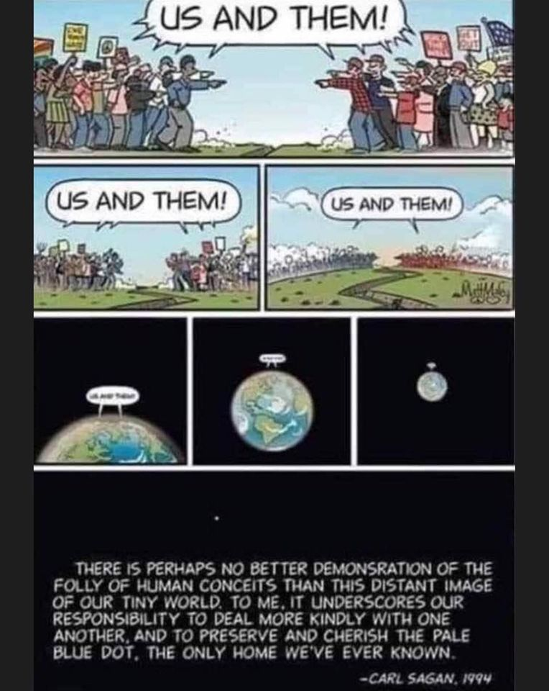
Let’s work together

